Slide 1

Data-driven

Slide 2
Data-driven development
When a company employs a “data-driven” approach, it means it makes strategic decisions based on data analysis and interpretation.
A data-driven approach enables companies to examine and organise their data with the goal of better serving their customers and consumers.
Clear, objective, and unambiguous, these metrics encourage development teams to think about the long-term strategic objectives of their day-to-day work and the business value of each project. The data allows these teams and individuals to visualize how their work contributes to business success, and how they can support the organization in meeting its vital goals.
Data-driven software development is based on solid metrics like Key Performance Indicators (KPIs) or Objectives And Key Results (OKRs).

Slide 3
Data-driven development (cont’d)
A Data driven software:
Automates processes, problems and opportunities.
Operates on diverse data from many multichannel data sources.
Makes information universally available within a single application.
Automatically generates master data, metadata, models, schema, and graphs as the user searches, queries and collects data.
Continuously co-relates data entities.

Slide 4
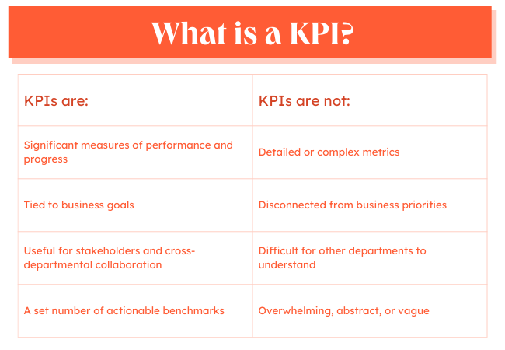
KPIs measure performance and progress toward a specific goal over time. They help keep the primary goals of a business at the forefront.

Slide 5
How To Determine KPIs
Choose KPIs directly related to your business goals.
1
Consider your company's stage of growth.
2
Focus on a few key metrics, rather than a slew of data.
3

Slide 6
KPI Metrics Example
Website KPI are
Traffic
Traffic sources
Number of sessions
Number of transactions

Slide 7

What is OKRs?
OKRs (Objectives & Key Results) are a popular tool for managing teams and measuring performance. They help your team prioritize what to do, track progress against those priorities, and identify opportunities for improvement.
They’re a process for setting goals, which helps your team think more clearly about what they want to achieve and how they want to measure their progress toward those goals. And once you understand all these pieces, it can help you get started with creating your own set of OKRs for your data team.

Slide 8
An example OKR
Objective: Run a marathon in under 4 hrs
Key results:
- Join a marathon training group
- Train 5 days per week with 1 long run each week
- Increase mileage by 5 miles per week
- Drink at least 3 litters of water every day
- Sleep at least 8 hours every night

Slide 9
An example OKR
A technology company has the objective of becoming one of the top 10 providers in their industry in 2023.
key results could be:
- Acquire 1,000 new customers by Q3.
- Generate 3,000 leads every month.
- Increase annual membership sales by 30%.

Slide 10
Data-driven modeling
Many business systems are data-processing systems that are primarily driven by data.
They are controlled by the data input to the system, with relatively little external event processing.
Data-driven models show the sequence of actions involved in processing input data and generating an associated output.
They are particularly useful during the analysis of requirements as they can be used to show end-to-end processing in a system.

Slide 11
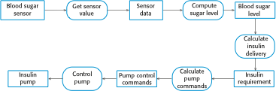
An activity model of the insulin pump’s operation

Slide 12
Decision support system (DSS)
A decision support system (DSS) is a computer program application used to improve a company's decision-making capabilities. It analyzes large amounts of data and presents an organization with the best possible options available.
Decision support systems bring together data and knowledge from different areas and sources to provide users with information beyond the usual reports and summaries. This is intended to help people make informed decisions.

Slide 13
Data-driven DSS
A data-driven DSS is a computer program that makes decisions based on data from internal databases or external databases.
Typically, a data-driven DSS uses data mining techniques to discern trends and patterns, enabling it to predict future events.
Businesses often use data-driven DSS to help make decisions about inventory, sales and other business processes.

Slide 14
Data Driven role in requirement gathering
By incorporating data-driven approaches into requirement gathering, organizations can build software that is more aligned with user needs, delivers a better user experience, and ultimately achieves greater success.
Data driven can help in:
1. Understanding User Needs and Behaviour:
- Analyse website analytics, app usage logs, customer surveys, social media feedback, support tickets, conduct user interviews, and focus groups.

Slide 15
Data Driven role in requirement gathering
2. Validating Existing Assumptions:
- Test initial hypotheses about user behaviour and preferences with data. Avoid biases and ensure alignment with user needs.
3. Reduced risk of failure:
- Avoid building features that don’t meet user expectations.

Slide 16
Data Driven role in Design stage
1. Guiding Information Architecture:
- Use data to determine the most important content and features for users. Structure the information architecture to highlight those elements effectively.
2. Enabling Data Visualization:
- Incorporating dashboards and charts:
Incorporate visual representations of key data points directly into the application interface.
Provide users with insights and trends relevant to their tasks and goals.
- Fostering data-driven decision-making:
Empower users to make informed choices based on data within the application itself.

Slide 17
Data Driven role in Development stage
By incorporating data-driven approaches into the development stage, organizations can build software that is more efficient, optimized, user-centric, and adaptable, leading to better performance, greater user satisfaction, and enhanced business outcomes.
Data driven can help in:
1. Guiding Development Prioritization:
Focusing on high-impact features: Use data insights to identify features that will have the most significant impact on user satisfaction, engagement, and business goals.
2. Informing Code Optimization:
Profiling code performance: Use data to identify performance bottlenecks and areas for optimization, leading to faster, more responsive applications.
Analysing user interactions: Gather data on how users interact with features and functions to optimize code for common usage patterns.

Slide 18
Data Driven role in testing stage
By incorporating data-driven approaches into the testing stage, organizations can achieve:
More comprehensive test coverage.
Early identification of defects.
Streamlined testing processes.
Improved test result analysis.
Enhanced software quality.
Faster release cycles.
Greater user satisfaction.

Slide 19
Case Studies & Real-World Applications
Example 1: Showcasing how a popular e-commerce website uses data to personalize product recommendations.
Example 2: Demonstrating how a mobile app leverages user location data to optimize delivery routes.
Example 3: Highlighting how a social media platform utilizes data for content moderation and trend analysis.

Slide 20
References
https://www.cloudzero.com/blog/data-driven-development
https://www.hatica.io/blog/software-development-lifecycle-best-practices/
https://atomgraph.com/blog/data-driven-software-architecture-1/
https://atomgraph.com/blog/data-driven-software-architecture-2/
https://www.w3.org/RDF/
https://www.techtarget.com/searchcio/definition/decision-support-system
https://devtalents.com/data-driven-software-development/

